Slide 1
CLAS 220 Introduction to Classical Mythology
Homer, Iliad 13-16

Slide 2
Quiz Question
Who seduces Zeus in the course of the Iliad?
Maia
Hera
Thetis
Briseis

Slide 3
Quiz Question
2. Who wears Achilles’ armor in this section of the poem?
Achilles
Odysseus
Neoptolemus
Patroclus

Slide 4
Quiz Question
3. Which of the following does Patroclus kill?
Hector
Ajax
Sarpedon
Achilles

Slide 5
Achilles’ Great Dilemma
kleos (fame) vs. nostos (homecoming)
If he gets one, he can’t have the other
In Book 1, he withdraws from battle
In Book 9, he seems to choose nostos over kleos
The Greek army suffers defeat after defeat
This section of the poem (Books 13-18) is about how to bring Achilles back to the battle

Slide 6
Achilles’ Return
Achilles’ return to battle and to the social world is part of a chain reaction of deaths.
Patroclus kills Sarpedon.
Hector kills Patroclus.
Achilles kills Hector.
Paris kills Achilles (after the end of the Iliad).

Slide 7
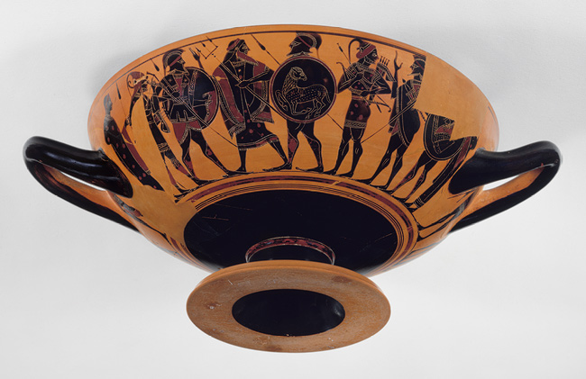
Poseidon Inspires the Ajaxes
“I wish you were inspired by some god
To hold the line hard, clamped hard here, you two,
Rallying others: you could block and turn
His whirwind rush away from the long ships,
Even if the Olympian sets him on.”
The god who girdles earth, even as he spoke,
Struck both men with his staff, instilling fury,
Making them springy, light of foot and hand.
Then upward like a hawk he soared – a hawk
That, wafted from a rockpoint sheer and towering
Shoots to strike a bird over the plain:
So arrowy in flight Poseidon left them.
The son of Oileus knew his nature first
And turned to say to the son of Telamon:
“That was one of the gods who hold Olympus,
Here in the seer’s shape telling us to fight
Abaft the ships. It was not Kalhkas, not
The reader of birdflight; from his stride, his legs
As he went off, I knew him for a god.
The gods are easily spotted! (13. 65-81)

Slide 8
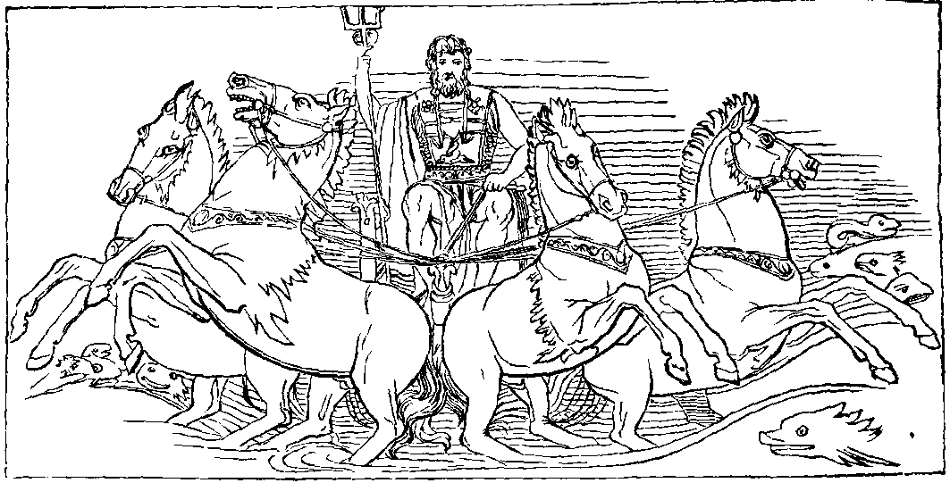
Hektor Kills Amphimakos
Poseidon, too,
grew hot over Amphimakhos, his grandson,
Passing amid the huts and ships, he kindled
fire in Danaans and devised Trojans' woe.
(13.234-237)

Slide 9
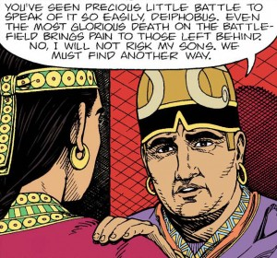
Idomeneus and Meriones Wound Deiphobus
The fight went on: Deiphobos took the dead man's
helm, but Meriones, fast as the wargod,
leaped and speared the Trojan's outstretched arm.
The crested helm fell with a hollow clang,
and with a falcon's pounce Meriones
regained his spear and jerked it from Deiphobos'
upper arm at the shoulder joint, then back
he turned to merge into his company. 13.600-607

Slide 10
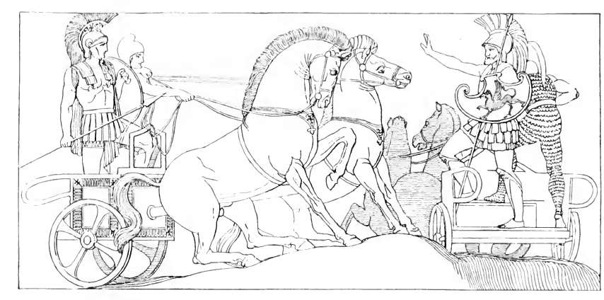
Polydamas Warns the Trojans
“Zeus gave you mastery in arms; therefore
You think to excel in strategy as well.
And yet you cannot have all gifts at once.
Heaven gives one man skill in arms, another
Skill in dancing, and a third man skill
At glittern harp and song; but the Lord Zeus
Who views the wide world has instilled clear thought
In yet another. By his aid men flourish,
And there are many he can save; he knows
Better than any what his gift is worth.
Let me tell you the best thing as I see it…
… I fear
The Akhaians may still pay the debt they owe
For yesterday, as long as the man we know,
Famished for battle, lingers on the beachhead:
I doubt he’ll keep from fighting any longer.”
This wariness won Hektor’s nod. (13.834-860)

Slide 11
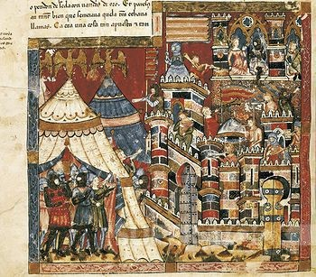
The Greeks, Despondent
Agamemnon hailed him, saying:
"Nestor, son of Neleus,
pride of Akhaians! Why turn this way, seaward,
away from the battle-danger? Now I fear
their champion, Hektor, will make good his word,
the threat he made in his harangue to Trojans,
not to return to Ilion from the beachead
until he fired our ships and killed our men.
So he proclaimed; now it is coming true.
My god, it seems the rest of the Akhaians,
like Akhilleus, hold a grudge against me!
They have no will to fight, to save the ships."
14.45-56

Slide 12
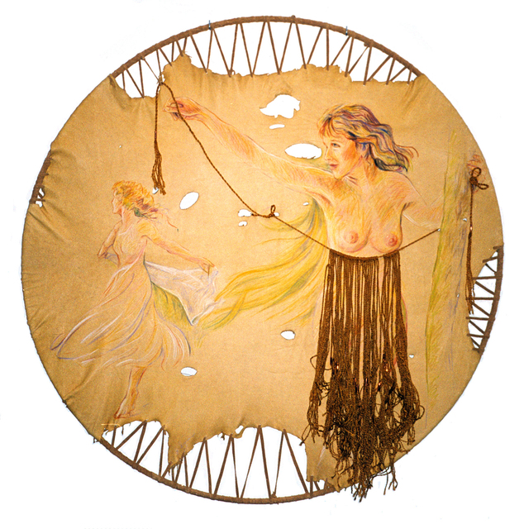
Aphrodite lends Hera her girdle
Aphrodite, lover of smiling eyes, replied to her:
"It is not possible
and not expedient, either, to deny you,
who go to lie in the great arms of Zeus.
Now she unfastened from around her breast
a pierced brocaded girdle. Her enchantments
came from this: allurement of the eyes,
hunger of longing, and the touch of lips
that steals all wisdom from the coolest men.
14.237-45

Slide 13
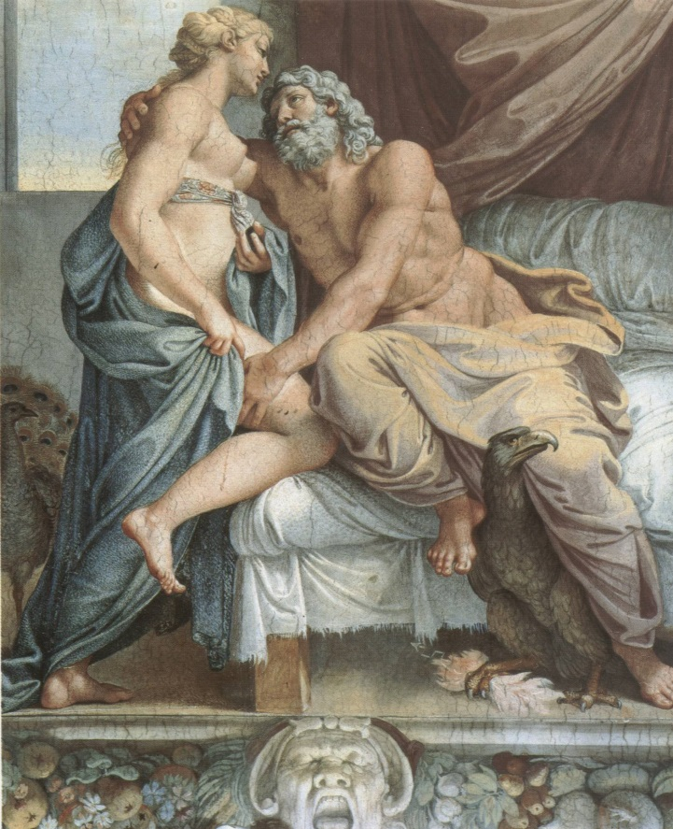
Hera Seduces Zeus
… her ladyship
Of the wide eyes took thought how to distract
Her lord who bears the stormcloud. Her best plan,
She thought, was this: to scent and adorn herself
And visit Ida, hoping hot desire
Might rise in him – desire to lie with her
And make love to her nakedness – that so
She might infuse warm slumber on his eyes
And over his shrewd heart… (14. 180-189)

Slide 14
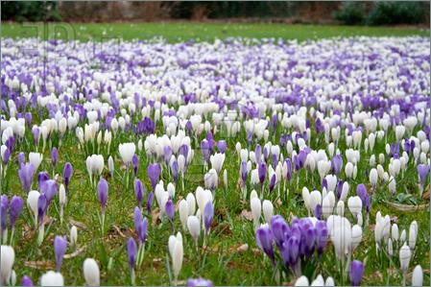
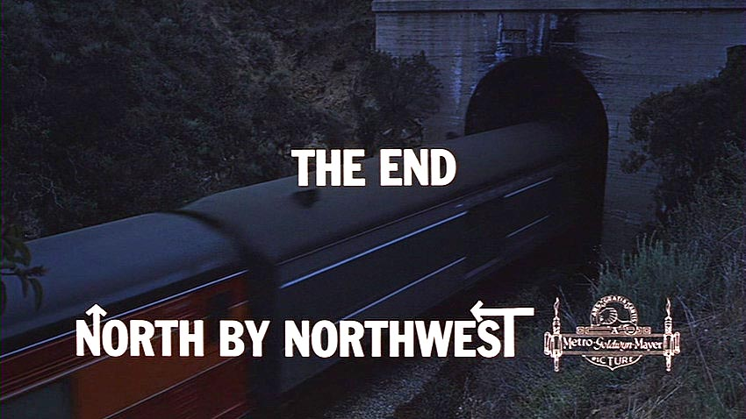
… continued
“No fear
This act will be observed by god or man,
I shall enshroud us in such golden cloud.
Not even Helios could glimpse us through it,
And his hot ray is finest at discerning.”
At this he took his wife in his embrace,
And under them earth flowered delicate grass
And clover wet with dew; then crocuses
And solid beds of tender hyacinth
Came crowding upward from the ground. On these
The two lay down and drew around them purest
Vapor of golden cloud; the droplets fell
Away in sunlight sparkling. Soon the Father,
Subjugated by love and sleep, lay still.
(14. 383-396)

Slide 15
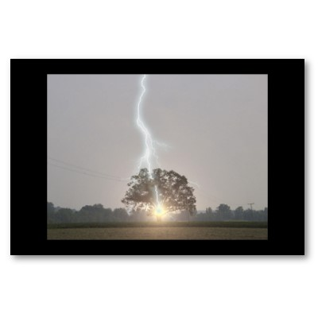
Poseidon Helps the Greeks I
“As an oak tree
Under the stroke of Father Zeus goes down,
Root and branch, and deadly fumes of brimstone
Rise from it, and no man’s courage keeps him
Facing it if he sees it – Zeus’s bolt
Being rough indeed – so all Hektor’s elan
Now dropped in dust. He flung his spear, his shield
And helm sank down with him, his blazoned armor
Clanged about him.”
(14. 462-470)

Slide 16
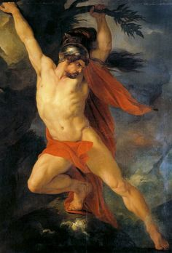
Poseidon Helps the Greeks II
Muses in your great Olympian halls
Tell me now what Akhaian most excelled
In winning bloodstained spoils of war
When the Earthsaker bent the battle line.
Aias Telamonios cut down
The Mysian leader, Hyrtios Gyrtiades;
….
After that, Menelaos hit Hyperenor’s
Flank, and the spearhead split his guts like water.
By the wound-slit, as by a doorway, life
Left him in haste, and darkness closed his eyes.
But Aias the swift runner, son of Oileus,
Killed more than any: none could chase as he could
A soldier panicked in that god-sent rout.
(14. 573-88)

Slide 17
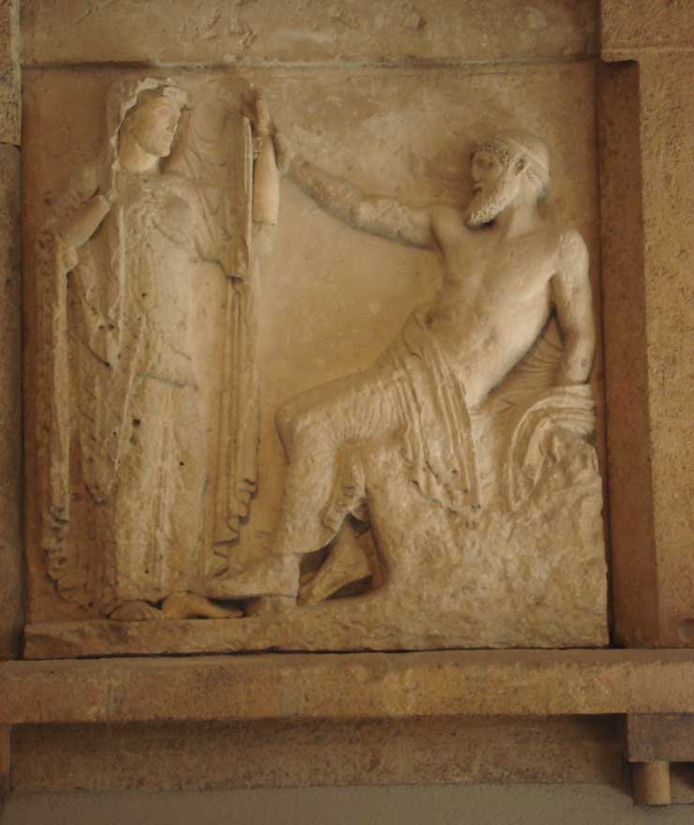
The Anger of Zeus
… and now Zeus
On Ida’s top by Hera’s queenly side
Awoke and rose in a single bound. He saw
The Trojans and Akhaians – Trojans routed,
Pressed by Akhaians whom Poseidon joined;
Saw Hektor stretched out on the battlefield,
Brothers-in-arms around him, squatting down
Where he lay, faint and fighting hard for breath,
Vomiting blood. The man who knocked him out
Was not the weakest of Akhaians. Watching
The father of gods and men was moved to pity.
He turned with a dark scowl and said to Hera:
“Fine underhanded work, eternal bitch!
Putting Lord Hektor out of action,
Breaking his fighting men! I should not wonder
If this time you will be the first to catch it,
A whip across your shoulders for your pains!
(15. 4-20)

Slide 18
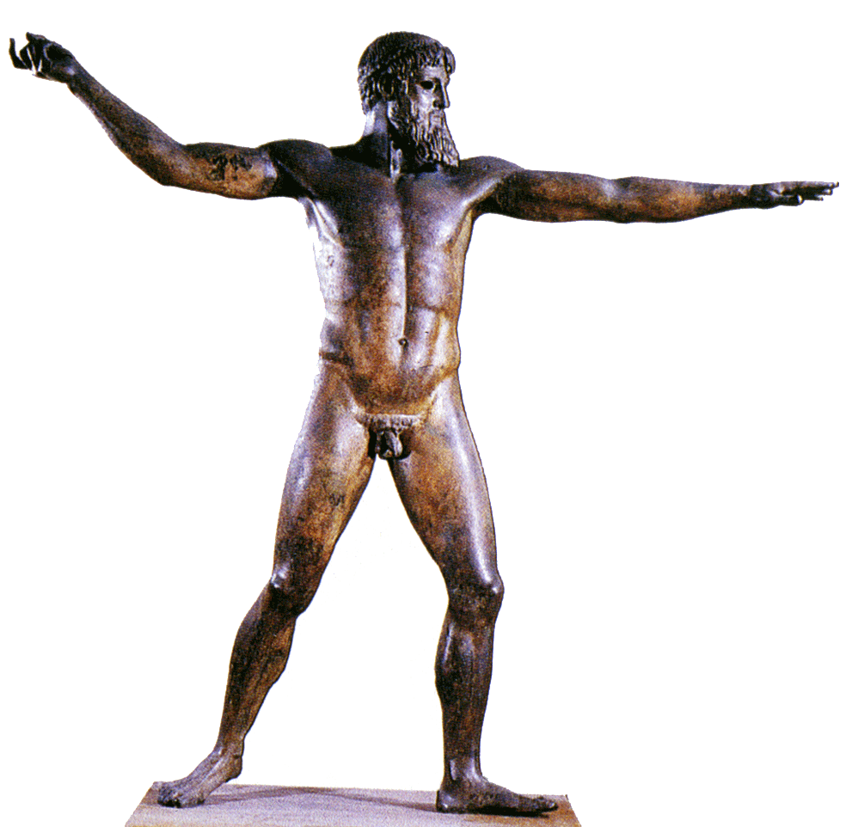
The Plan of Zeus
… Let Hektor
Shatter the Akhaians into retreat,
Helpless, in panic, till they reach the ships
Of Peleus’ son, Akhilleus. Then that prince
Will send Patroklos, his great friend, to war,
And Hektor in glory before Ilion
By a spear-cast will bring Patroklos down,
Though he destroy a host of men, my son,
Sarpedon, being among them. Aye, for this
The Prince Akhilleus in high rage
Will kill heroic Hektor. From that moment
I’ll turn the tide of battle on the beach
Decisively, once and for all,
Until the Akhaians capture Ilion,
As Athena planned and willed it. But until
That killing I shall not remit my wrath.
(15.72-87)

Slide 19
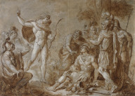
… but first, Apollo helps Hektor
And standing near the man, Apollo said,
"Hektor, why do you sit here, weak and sick,
far from the rest? What has come over you?"
And Hektor of the shining helmet answered,
whispering hoarsely: "Excellency, who are you?
A god? What god, to face and question me?
Do you not know that near the Akhaian sterns
Aias hit my chest with a great stone
and knocked the fighting spriit out of me?
In fact I thought this day I'd see the dead
in the underworld -- I thought I had breathed my last!"
15. 284-295

Slide 20
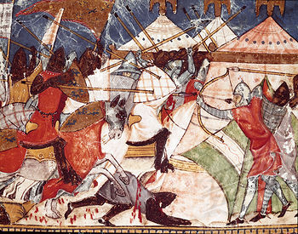
The Wall Breached, Again
Ajax speaks:
“Friends, Danaan soldiers, hands of Ares,
Take a fresh grip on courage! Fight like men!
Can we rely on fresh reserves behind us?
A compact wall, to shield our men from death?
Not that, nor any town with towers where
We might defend ourselves and find allies
Enough to turn the tide. No, here we are,
On the coastal plain of Trojans under arms,
Nothing but open sea for our support,
And far from our own country. Safety lies
In our own hands, not going soft in battle.”
(15. 848-859)

Slide 21
Quiz Question
4. Who kills Patroclus?
Hector
Ajax
Odysseus
Achilles

Slide 22
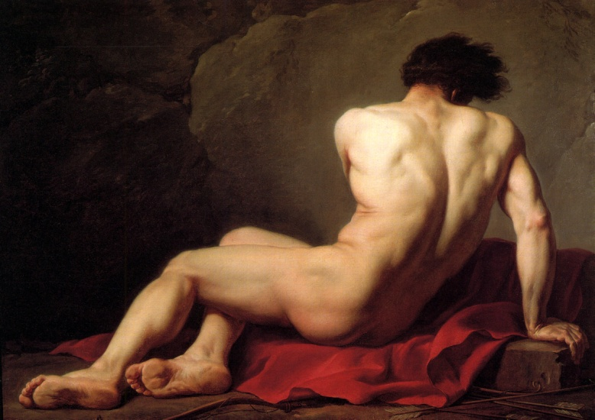
Akhilleus and Patroklos
In Troy, they’re just cousins.
They’re clearly very close friends.
They grew up together (Patroclus had to flee his home after an accidental homicide)
They may be lovers.
This is not explicit in the poem, but is discussed in other sources (Aeschylus)
Patroklos is also a therapon (“ritual substitute” for Akhilleus
His death acts as a precursor of Achilles’ own.

Slide 23
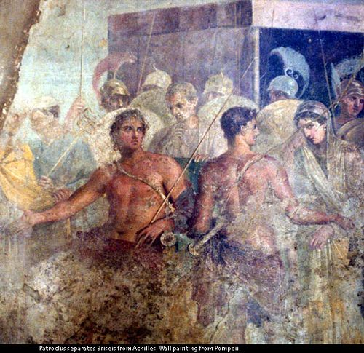
Patroclus Decides to Fight
… meanwhile Patroklos
Approached Akhilleus his commander, streaming
Warm tears – like a shaded mountain spring
That makes a rockledge run with dusky water.
Akhilleus watched him come, and felt a pang for him.
Then the great prince and runner said: “Patroklos,
Why all the weeping? Like a small girlchild
Who runs beside her mother and cries and cries
To be taken up, and catches at her gown,
And will not let her go, looking up in tears
Until she has her wish: that’s how you seem,
Patroklos, winking out your glimmering tears.
(16. 2-13)

Slide 24
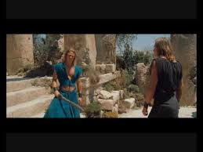
Patroclus Takes Achilles’ Armor
… but you, now, you can strap my famous gear
On your own shoulders, and then take command
Of Myrmidons on edge and ripe for combat,
Now that like a dark stormcloud the Trojans
Have poured round the first ships, and Argive troops
Have almost no room for maneuver left…
16.73-79
… you must not,
For joy of battle, joy of killing Trojans,
Carry the fight to Ilion!
16. 107-109

Slide 25
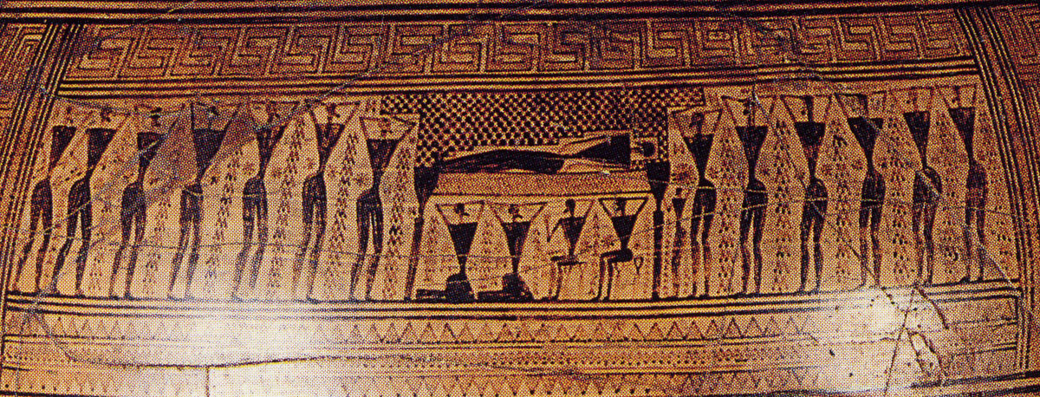
How to Pray to a Greek God
Sacrifice or pour a libation
Refer to the god or gods by as many names as possible
Don’t leave anyone out
Mention previous favors you’ve done
Make your request

Slide 26
Achilles Prays to Zeus
“Zeus of Dodona, god of Pelasgians,
O god whose home lies far! Ruler of wintry
Harsh Dodona! Your interpreters,
The Selloi, live with feet like roots, unwashed,
And sleep on the hard ground. My lord, you heard me
Praying before this, and honored me
By punishing the Akhaian army. Now,
Again, accomplish what I most desire.
I shall stay on the beach, behind the ships,
But send my dear friend with a mass of soldiers,
Myrmidons, into combat. Let your glory,
Zeus who view the wide world, go beside him.
Sir, exalt his heart,
So Hektor too may see whether my friend
Can only fight when I am in the field,
Or whether singlehanded he can scatter them
Before his fury! When he has thrown back
Their shouting onslaught from the ships, then let him
Return unhurt to the shipways and to me,
His gear intact, with all his fighting men.”
That was his prayer, and Zeus who views the wide world
Heard him. Part he granted, part denied:
He let Patroklos push the heavy fighting
Back from the ships, but would not let him come
Unscathed from battle.
16. 275-299

Slide 27
Hera and Zeus Debate the Death of Sarpedon
Then Hera of the wide eyes answered him: “O fearsome power,
My lord Zeus, what a curious thing to say.
A man who is born to die, long destined for it,
Would you set free from that unspeakable end?
Do so; but not all of us will praise you.
And this, too, I may tell you: ponder this:
Should you dispatch Sarpedon home alive,
Anticipate some other god’s desire
To pluck a man he loves out of the battle.
Many who fight around the town of Priam
Sprang from immortals; you’ll infuriate these.
No, dear to you though he is, and though you mourn him,
Let him fall, even so, in the rough battle,
Killed by the son of Menoitios, Patroklos.
Afterward, when his soul is gone, his lifetime
Ended, Death and sweetest Sleep can bear him
Homeward to the broad domain of Lykia.
There friends and kin may give him funeral
With tomb and stone, the trophies of the dead.”
(16. 503-530)
He said to Hera:
Sorrow for me, that in the scheme of things
The dearest of men to me must lie in dust
Before the son of Menoidios, Patroklos.
My heart goes two ways as I ponder this:
shall I catch up Sarpedon
Out of the mortal fight with all its woe
And put him down alive in Lykia,
In that rich land? Or shall I make him fall
Beneath Patroklos’ hard-thrown spear?

Slide 28
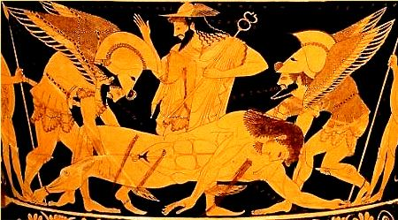
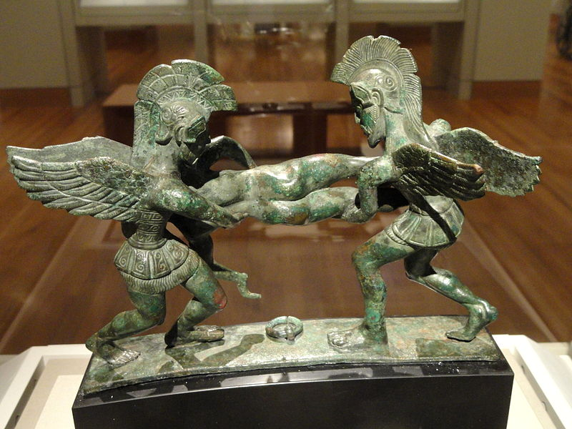
The Death of Sarpedon
Patroklos hit his enemy
Just where the muscles of the diaphragm
Encased his throbbing heart. Sarpedon fell
The way an oak or poplar or tall pine
Goes down, when shipwrights in the wooded hills
With whetted axes chop it down for timber.
So, full length, before his war-car lay
Sarpedon raging, clutching the bloody dust.
Imagine a greathearted sultry bull
A lion kills amid a shambling herd:
With choking groans he dies under the claws.
So, mortally wounded by Patroklos
The chief of Lykian shieldsmen lay in agony
And called his friend by name…
(16. 557-570)

Slide 29
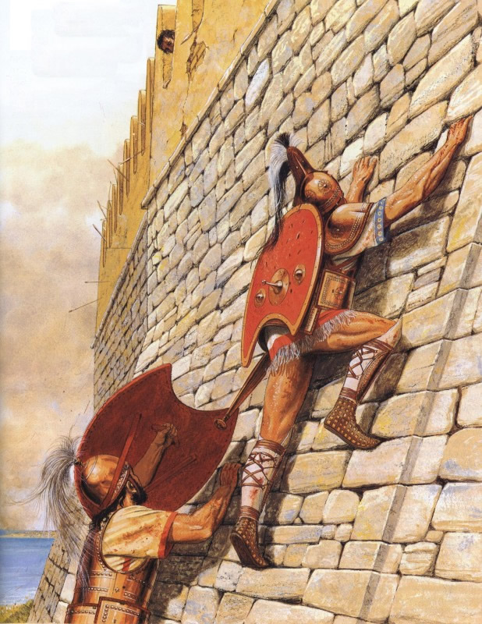
Patroklos reaches the walls of Troy
Troy of the towering gates was on the verge
of being taken by the Akhaians, under
Patroklos' drive: he raced with bloodied spear
ahead and around it. On the massive tower
Phoibos Apollo stood as Troy's defender,
deadly toward him. Now three times Patroklos
assaulted the high wall at the tower joint,
and three times Lord Apollo threw him back
with counterblows of his immortal hands
against the resplendent shield. The Akhaian then
a fourth time flung himself against the wall,
more than human in fury. But Apollo
thundered: " Back, Patroklos, lordly man!
Destiny will not let this fortress town
of Trojans fall to you! Not to Akhilleus,
either, greater far though he is in war!"
16.800-815

Slide 30
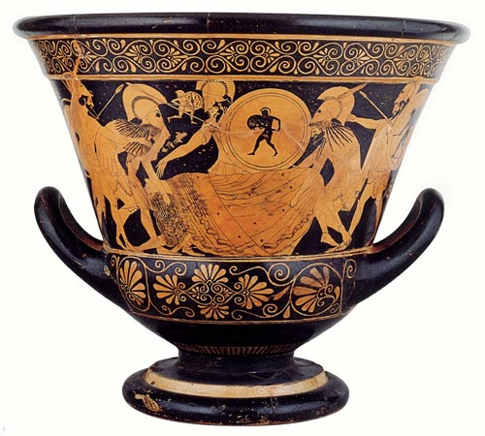
Patroklos Slain
In a low faint voice,
Patroklos, master of horse, you answered him [Hektor]:
“This is your hour to glory over me,
Hektor. The lord Zeus and Apollo gave you
The upper hand and put me down with ease.
They stripped me of my arms. No one else did.
Say twenty men like you had come against me,
All would have died before my spear.
No, Leto’s son and fatal destiny
Have killed me; if we speak of men, Euphorbos.
You were in third place, only in at the death.
I’ll tell you one thing more; take it to heart.
No long life is ahead for you. This day
Your death stands near, and your immutable end,
At Prince Akhilleus’ hands.”
(16. 968-82)

Slide 31
Quiz Question
5. Which of the following is NOT part of the Plan of Zeus?
Hector kills Patroclus
Patroclus kills Sarpedon
Odysseus kills Astyanax
Achilles kills Hector

